Slide 1
Behavioral Health Provider Enrollment Workshop
Conduent
Government Healthcare Solutions

Slide 2
Purpose
The purpose of this workshop is to provide an overview of the enrollment process and maintenance of accurate provider records. Understanding these processes will improve the timeliness of obtaining and maintaining your active provider status with New Mexico Medicaid.

Slide 3
Objectives
We will review the following:
New Mexico Web Portal Information and Enhancements
Web Portal Application Submission Process
Application Tips
Return to Provider (RTP)
Turn Around Documents (TAD)
Update Requests

Slide 4
New Mexico Web Portal Information and Enhancements
Conduent
Government Healthcare Solutions

Slide 5
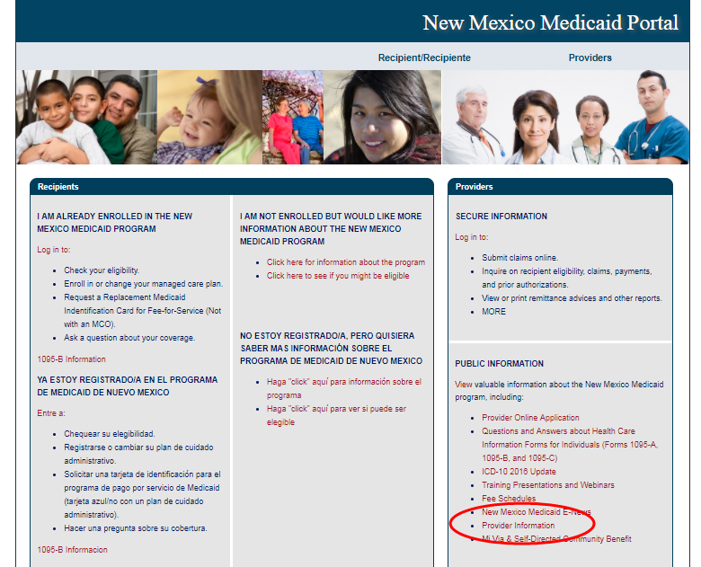
New Mexico Web Portal Information and Enhancements
Notes:
How to get to Provider Search Function

Slide 6
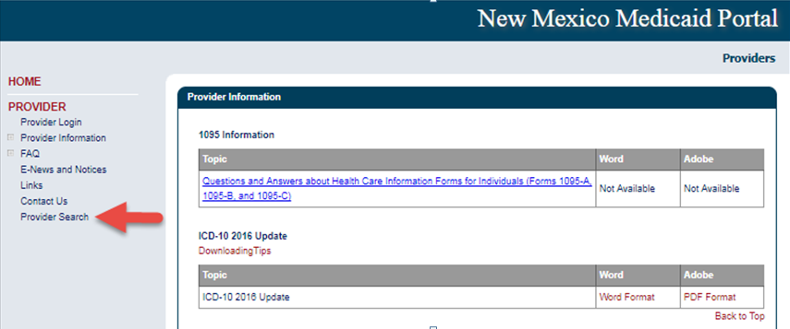
New Mexico Web Portal Provider Search

Slide 7
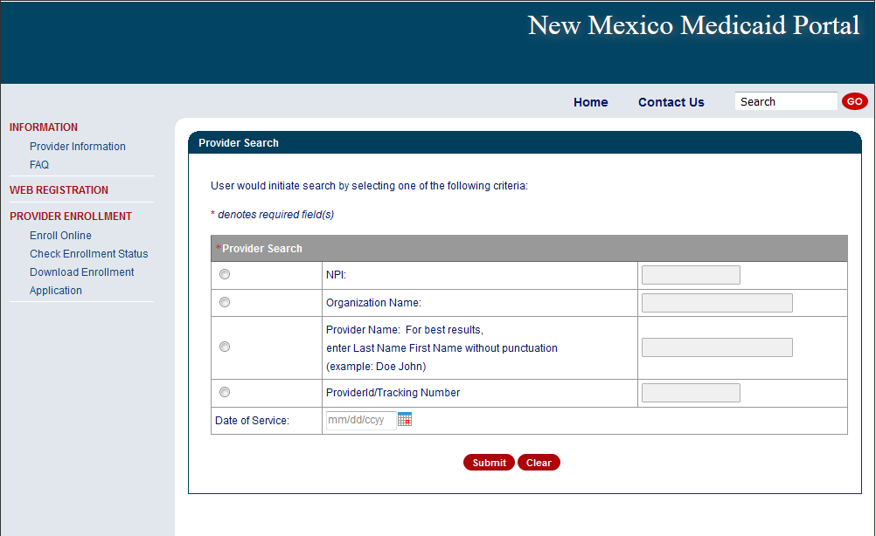
New Mexico Web Portal Provider Search

Slide 8
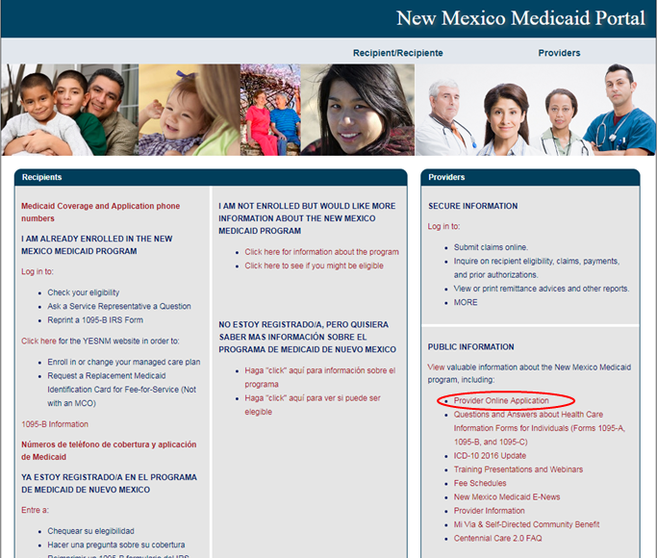
New Mexico Web Portal Information and Enhancements
Notes:
Speaker Note: Users can also access Provider Search from the Check Enrollment Status option.

Slide 9
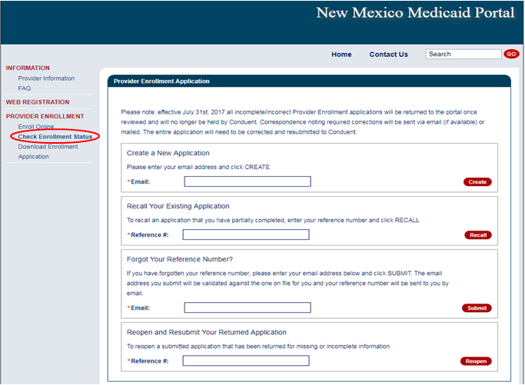
New Mexico Web Portal Information and Enhancements
Notes:
Click on Check Enrollment Status

Slide 10
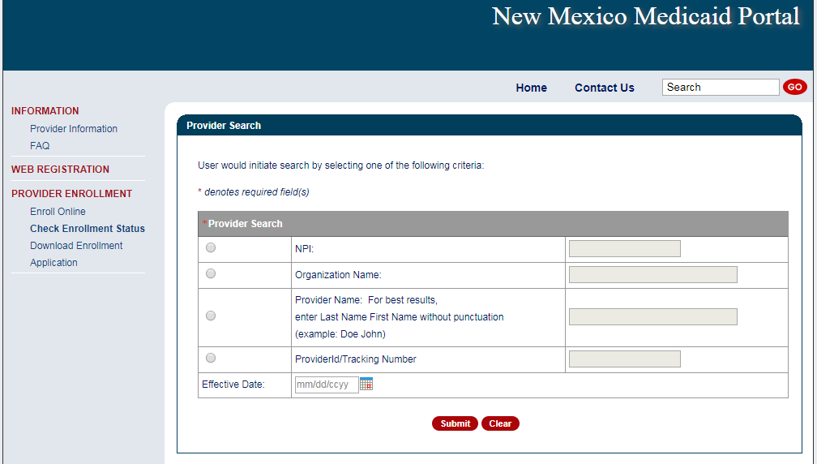
New Mexico Web Portal Information and Enhancements
Notes:
Speaker Notes: New fields are
Provider ID/Tracking Number
User can enter either a Medicaid Provider ID or a Provider Enrollment Application Tracking Number
Effective Date
User can enter a specific date of service or leave the field blank
If date field is left blank, search will default to “today’s date” or the date the search is launched.
Results changes are:
Enrollment Status results will now include RTP and terminated status codes
Multiple results can appear simultaneously
Provider records without NPI will appear in the results

Slide 11
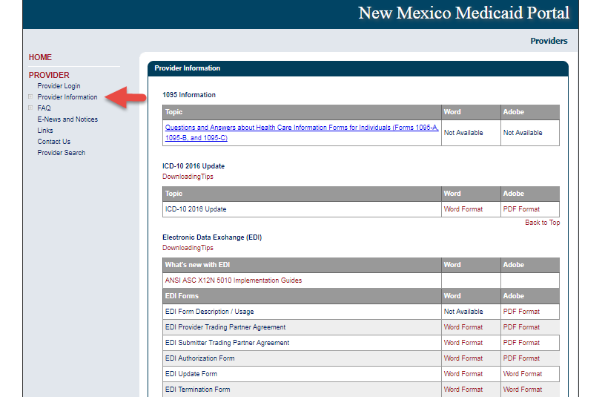
New Mexico Web Portal Information and Enhancements

Slide 12
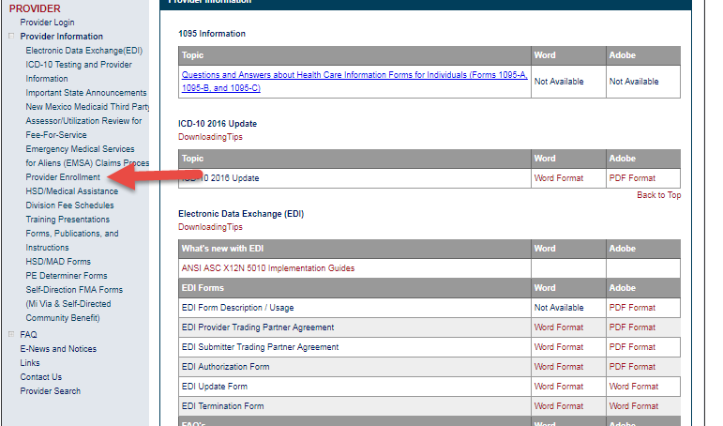
New Mexico Web Portal Information and Enhancements

Slide 13
Web Portal Application Submission Process
Conduent
Government Healthcare Solutions

Slide 14
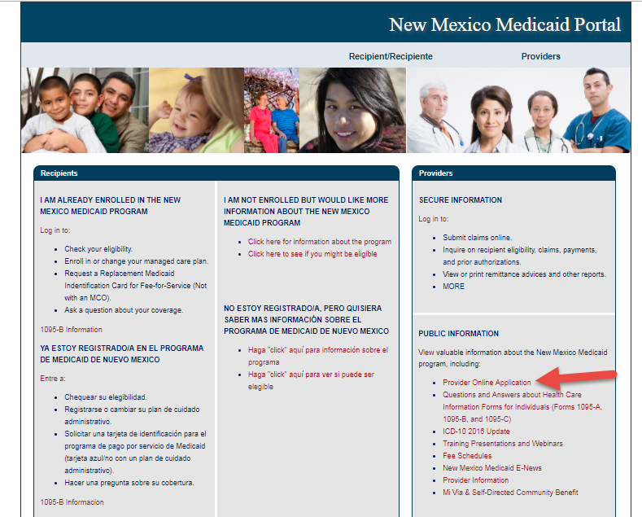
NM Medicaid Web Portal Application Location
https://nmmedicaid.portal.conduent.com/webportal/enrollOnline

Slide 15
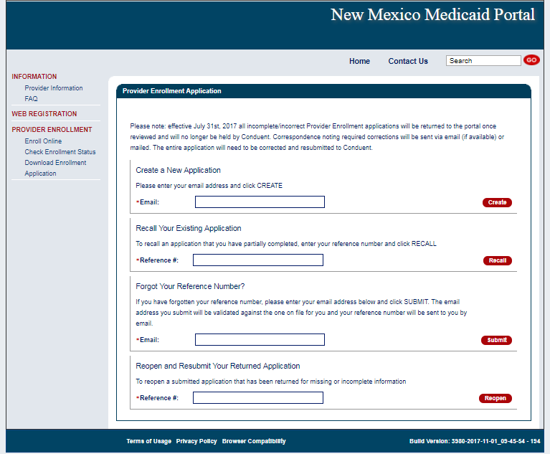
Provider Enrollment Application Initial Screen

Slide 16
Provider Enrollment Application Initial Screen
Begin your application by entering your email

Slide 17
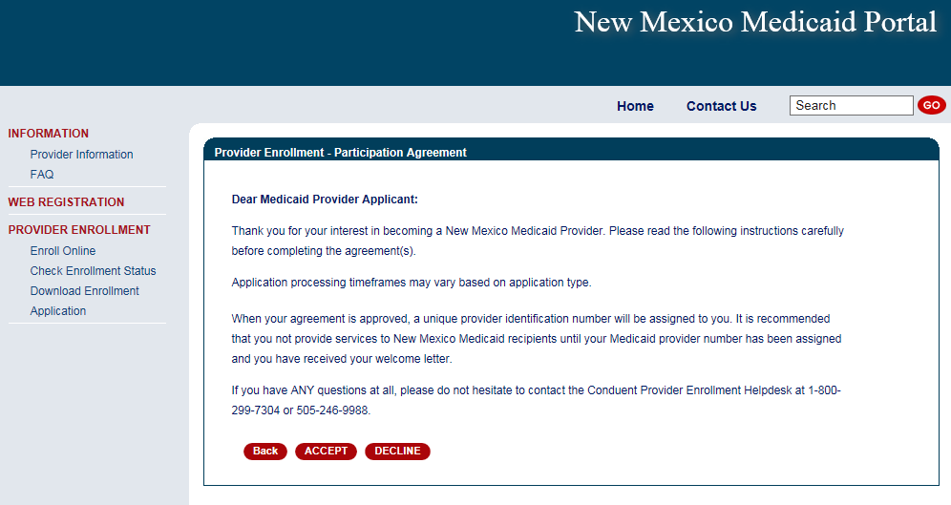
Provider Participation Agreement (Application)

Slide 18
Selecting the Right Application Form
MAD 335 - Medicaid Provider Participation Agreement for groups, organizations, facilities, or individual applicants to whom payments will be made (including CSAs, FQHCs, Hospitals, Pharmacies, etc.)
MAD 312 - Medicaid Provider Participation Agreement for individual applicant within group (including Psychologists, MDs, CNPs, LCSWs, LMHCs, etc.)
Please review the Provider Type and Specialty List for a complete list of documents that must be included with the Application, as well as applicable enrollment restrictions

Slide 19
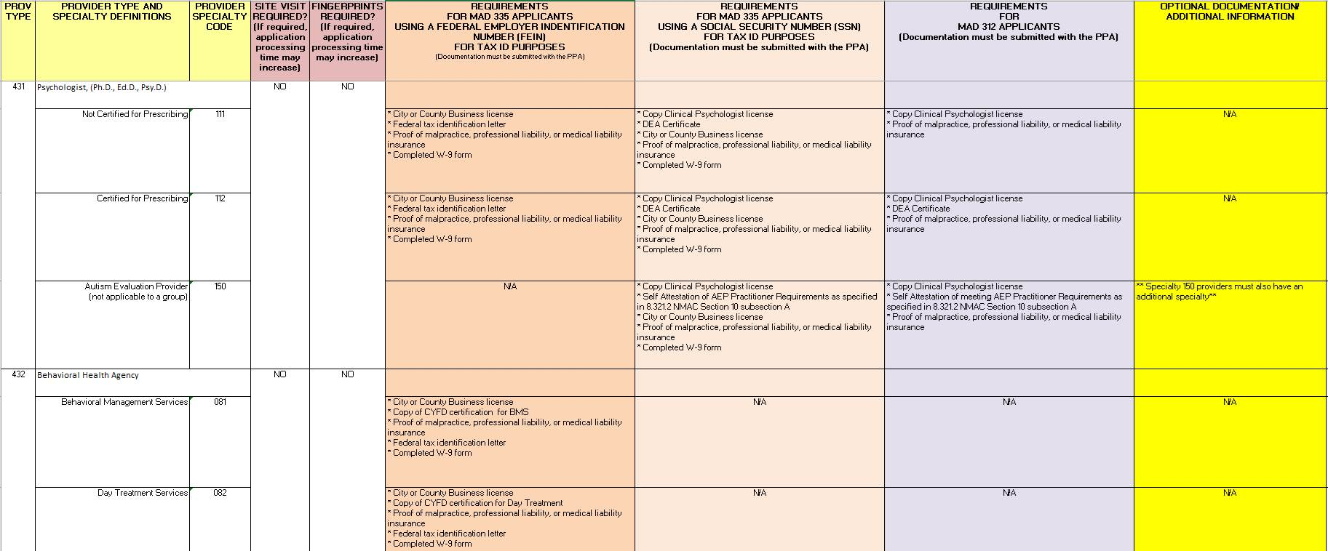
Provider Type & Specialty List

Slide 20
Online Provider Enrollment Features
Reminder: After your application has been approved, Providers that wish to see managed care recipients must also contact each of the Centennial Care Managed Care Organizations (MCOs) and follow their instructions for the credentialing and/or contracting process with them.
Centennial Care MCOs | Contact Number | Website
BlueCross BlueShield of New Mexico | (866) 689-1523 | www.bcbsnm.com/community-centennial/
Presbyterian | (888) 977-2333 | www.phs.org
Western Sky Community Care | (844) 543-8996 | www.westernskycommunitycare.com

Slide 21
Centennial Care Managed Care Organizations (MCOs)
Reminder: Recipients who are enrolled in Centennial Care, will have their claims submitted directly to the Managed Care Organization they have chosen. Below is the contact information for those MCOs.
Centennial Care MCOs | Contact Number | Website
BlueCross BlueShield of New Mexico | (866) 689-1523 | www.bcbsnm.com/community-centennial/
Presbyterian | (888) 977-2333 | www.phs.org
Western Sky Community Care | (844) 543-8996 | www.westernskycommunitycare.com

Slide 22
Web Portal Application Submission Process – MAD 312
Conduent
Government Healthcare Solutions

Slide 23
Web Portal Application Submission Process – MAD 312
MAD 312 applications are used to enroll individuals who perform services within a group or organization
Select either:
Fee-For-Service (FFS) and Managed Care Organization (MCO) network or Fee-For-Service (FFS) only.
Managed Care Organization (MCO) Only
Click on “initial enrollment” and “continue”

Slide 24
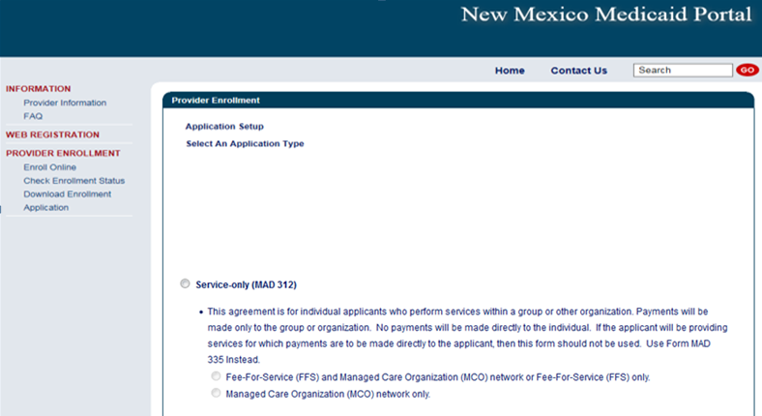
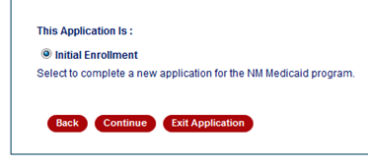
Web Portal Application Submission Process – MAD 312

Slide 25
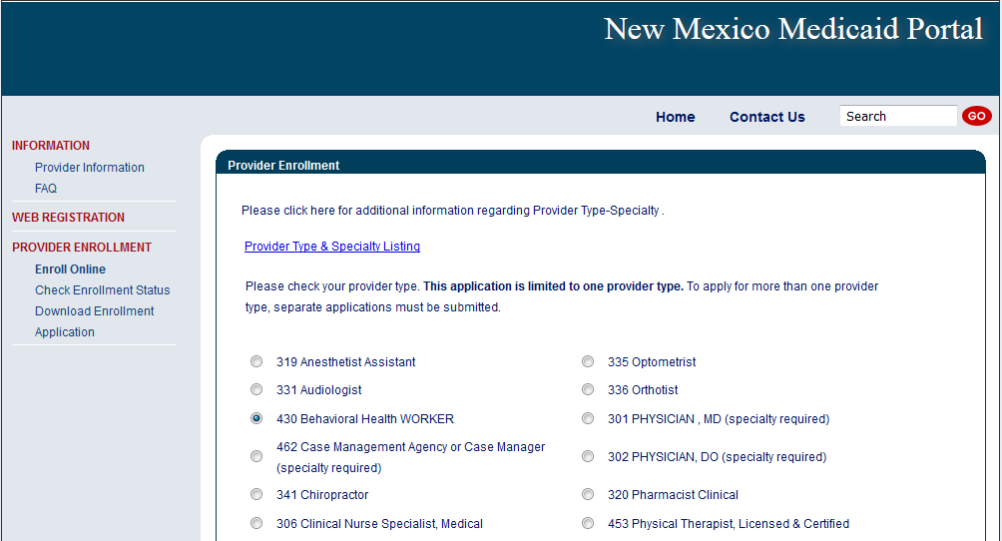
Web Portal Application Submission Process – MAD 312
Choosing a provider type: Use the Provider Type & Specialty Listing link on the portal to view your provider type and the required documentation associated with that provider type.

Slide 26
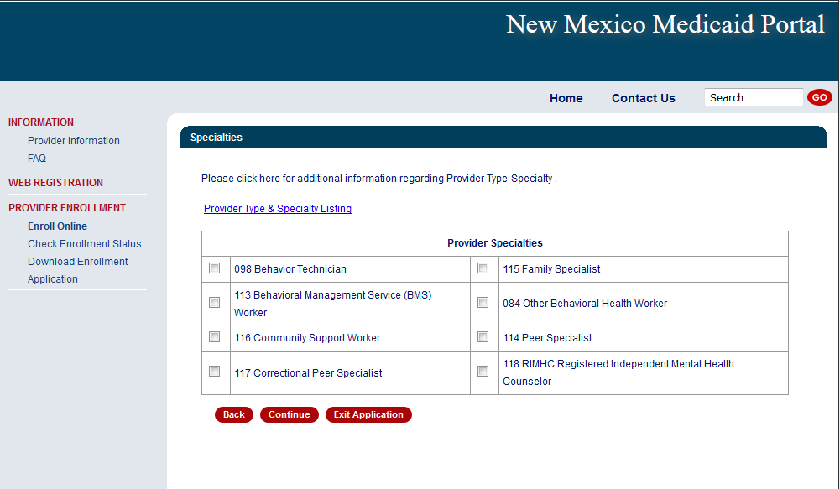
Web Portal Application Submission Process – MAD 312
Please click on the specialty being requested
Note: not all provider types require a specialty

Slide 27
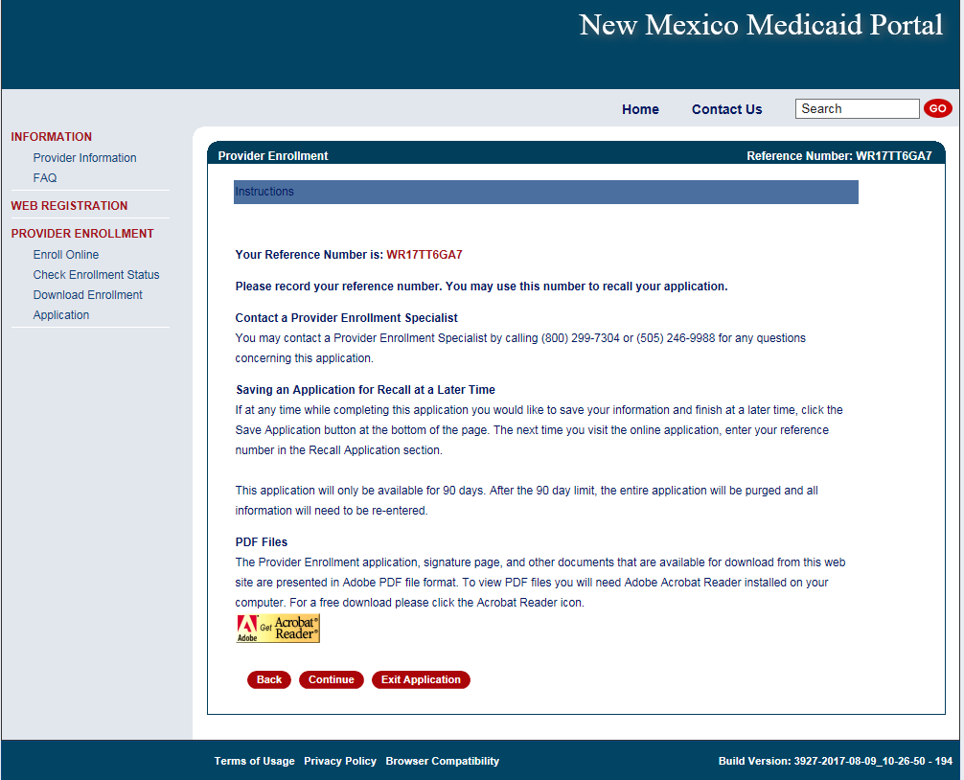
Web Portal Application Submission Process – MAD 312
Please take note of your Reference Number. This will be the number you use to retrieve the application later.

Slide 28
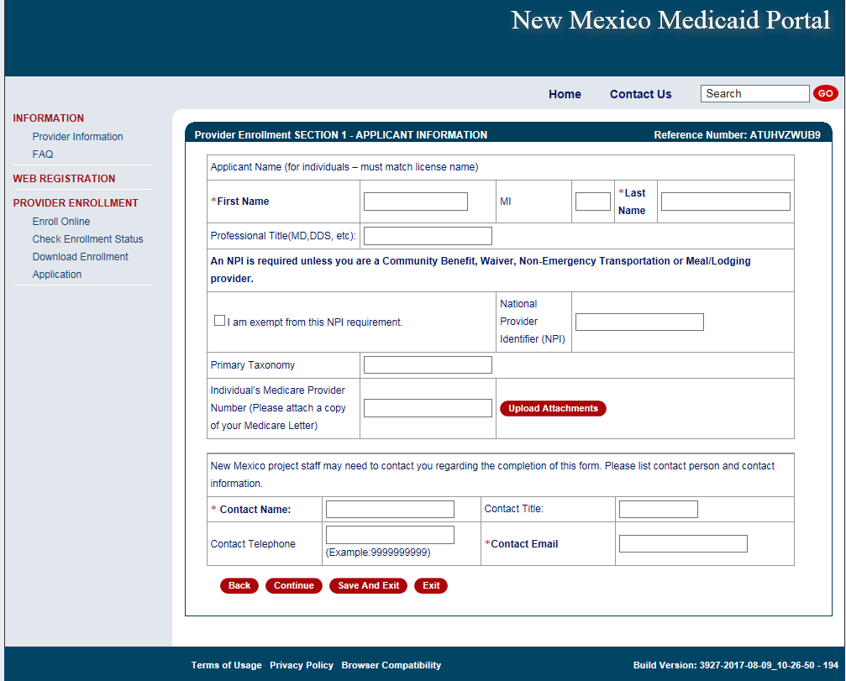
Web Portal Application Submission Process – MAD 312
The provider’s name, NPI, Medicare Number (if applicable), and a contact person is entered here.

Slide 29
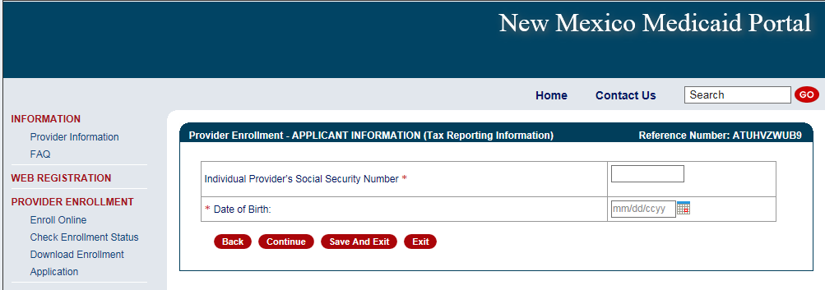
Web Portal Application Submission Process – MAD 312

Slide 30
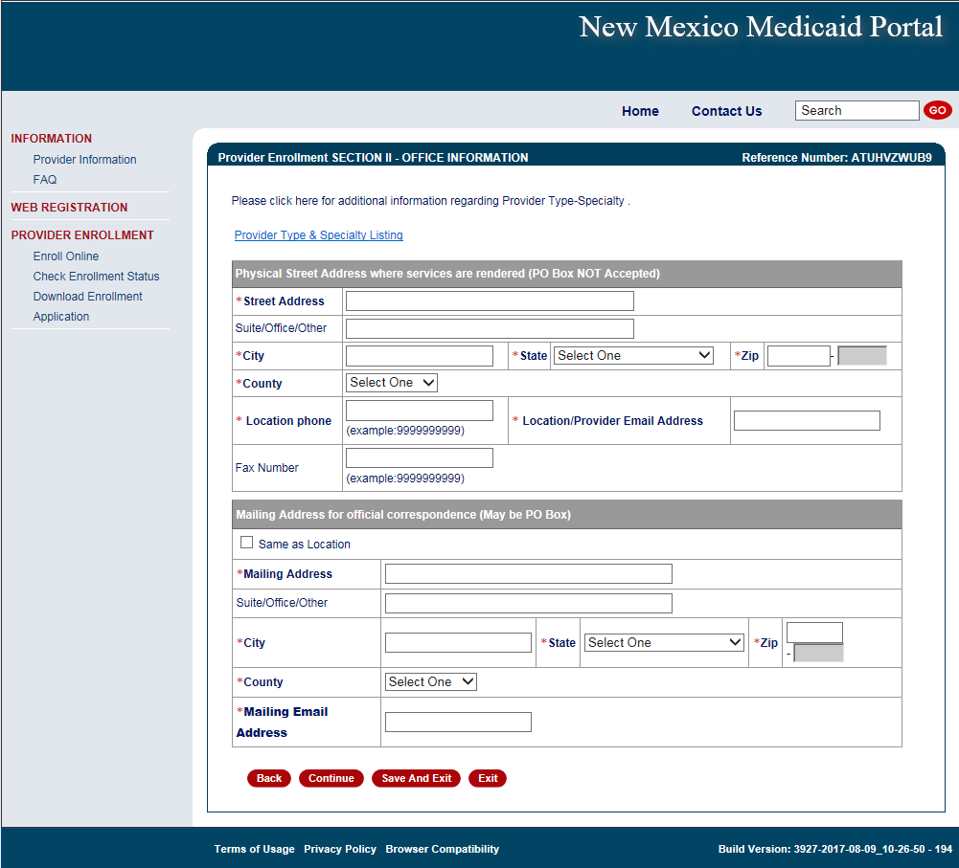
Web Portal Application Submission Process – MAD 312
Practice location address and mailing address are both required

Slide 31
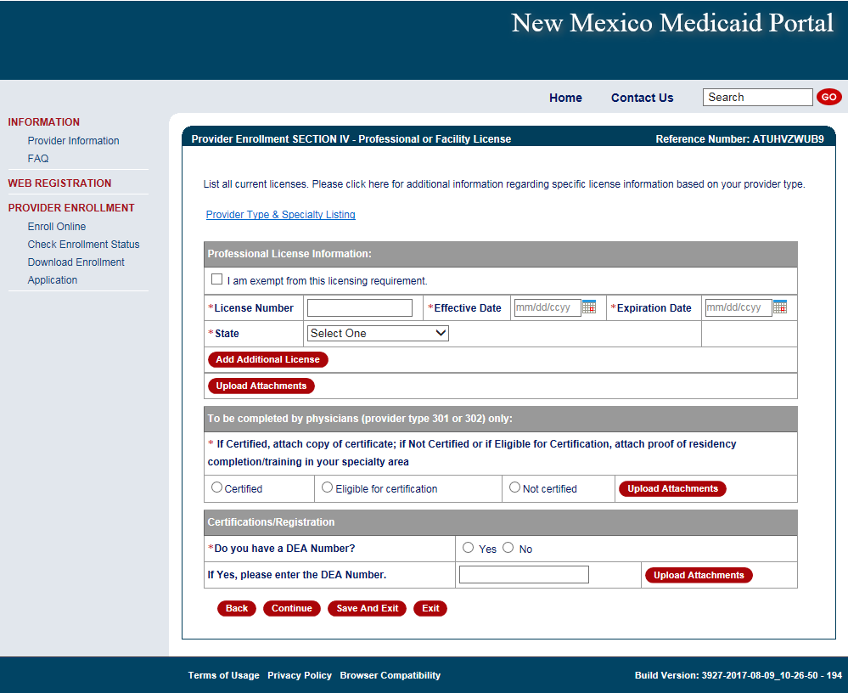
Web Portal Application Submission Process – MAD 312
The State issuing the professional license and the State in which the provider is practicing must match (with the exception of providers affiliating with IHS)
Note: Telemedicine providers should submit professional license from their home state (not Telemedicine license alone)
Notes:
Mention certification website for providers to get effective dates for providers only to obtain.

Slide 32
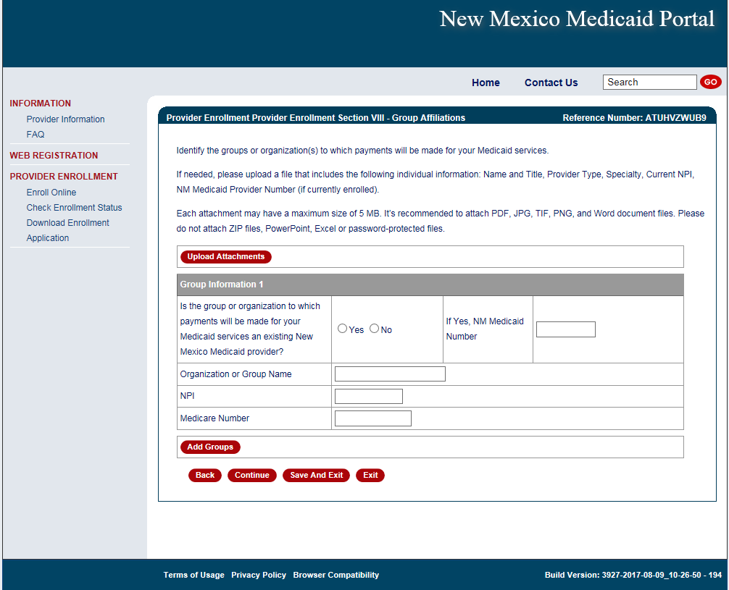
Web Portal Application Submission Process – MAD 312
Enter billing group information

Slide 33
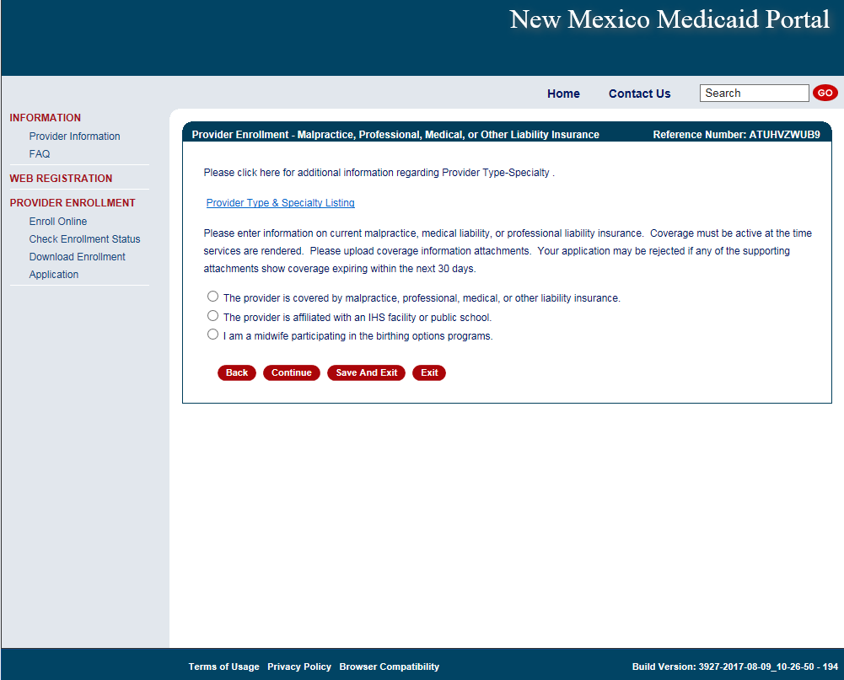
Web Portal Application Submission Process – MAD 312
Select professional liability type
Notes:
If you are a midwife participating in the birthing options program be sure to also submit supplemental agreement and affidavit of insurance.

Slide 34
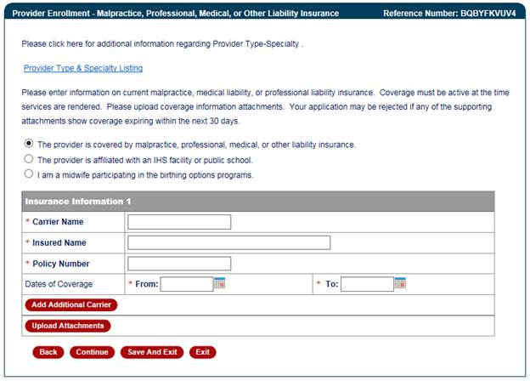
Provider Enrollment Application
Attach proof of professional liability if applicable
Attach proof of professional liability

Slide 35
Web Portal Application Submission Process – MAD 335
Conduent
Government Healthcare Solutions

Slide 36
Web Portal Application Submission Process – MAD 335
MAD 335 applications are used to enroll providers to whom payment will be made
Select either:
Fee-For-Service (FFS) and Managed Care Organization (MCO) network or Fee-For-Service (FFS) only.
Managed Care Organization (MCO) Only
Click on “initial enrollment” and “continue”

Slide 37
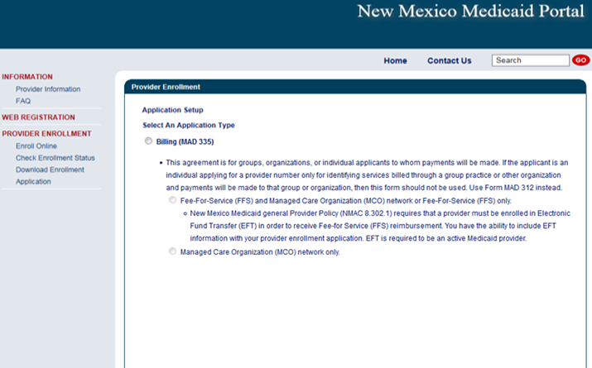
Web Portal Application Submission Process – MAD 335

Slide 38
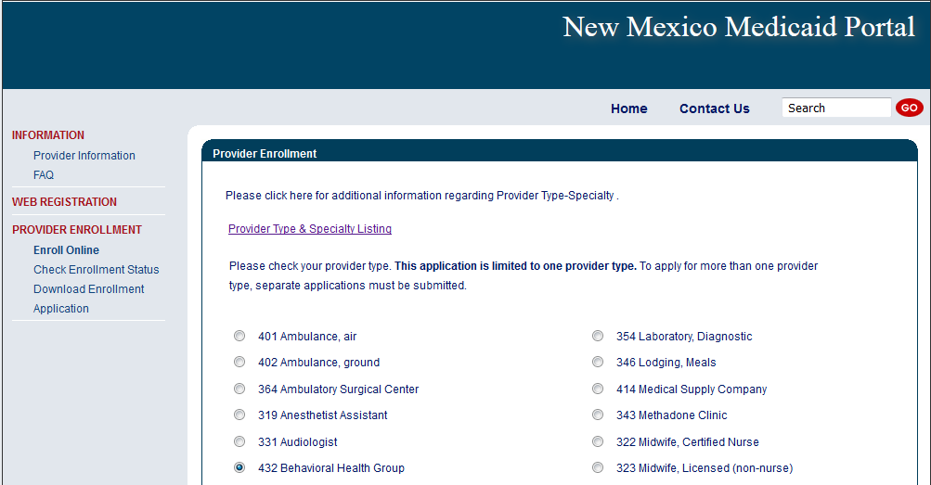
Web Portal Application Submission Process – MAD 335
Choosing a provider type: Use the Provider Type & Specialty Listing link on the portal to view your provider type and the required documentation associated with that provider type.

Slide 39
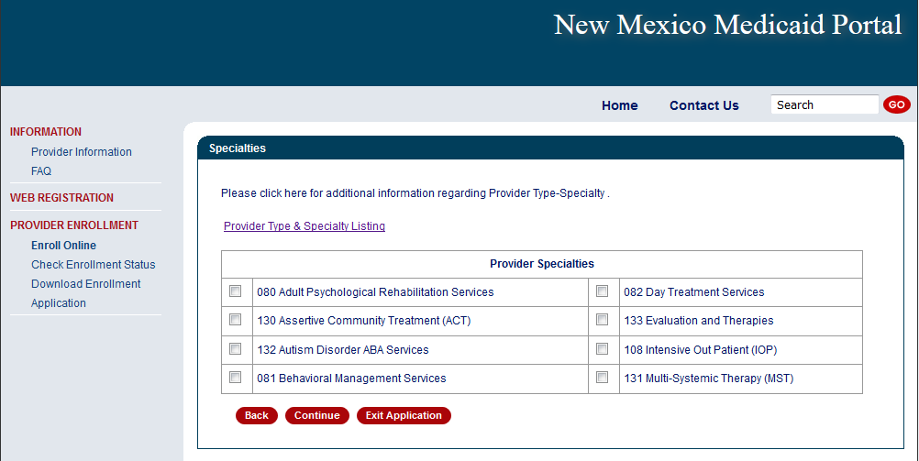
Web Portal Application Submission Process – MAD 335
Click on the specialty being requested
Note: not all provider types require a specialty

Slide 40
Web Portal Application Submission Process – MAD 335
Take note of your Reference Number. This will be the number you use to retrieve the application later.

Slide 41
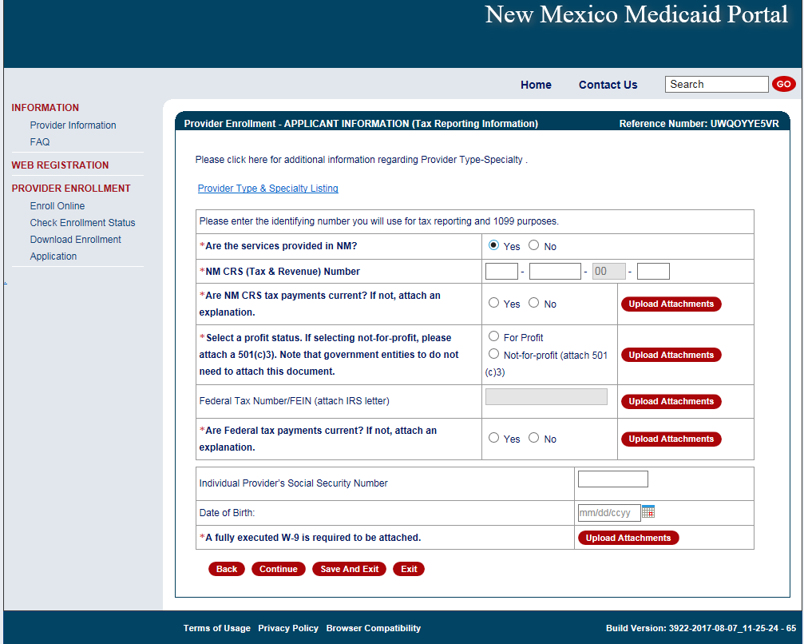
Web Portal Application Submission Process – MAD 335
If services are provided in NM, a CRS number is needed
Only one type of tax identification number can be added to this page (either Employer Identification Number or Social Security Number, not both)

Slide 42
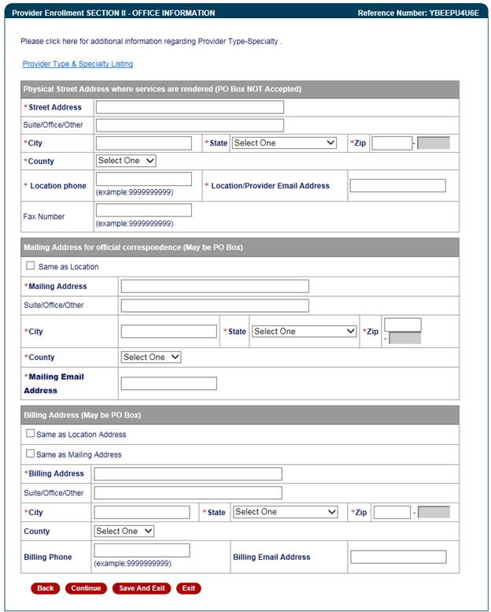
Web Portal Application Submission Process – MAD 335
Practice location address, mailing and billing address are required

Slide 43
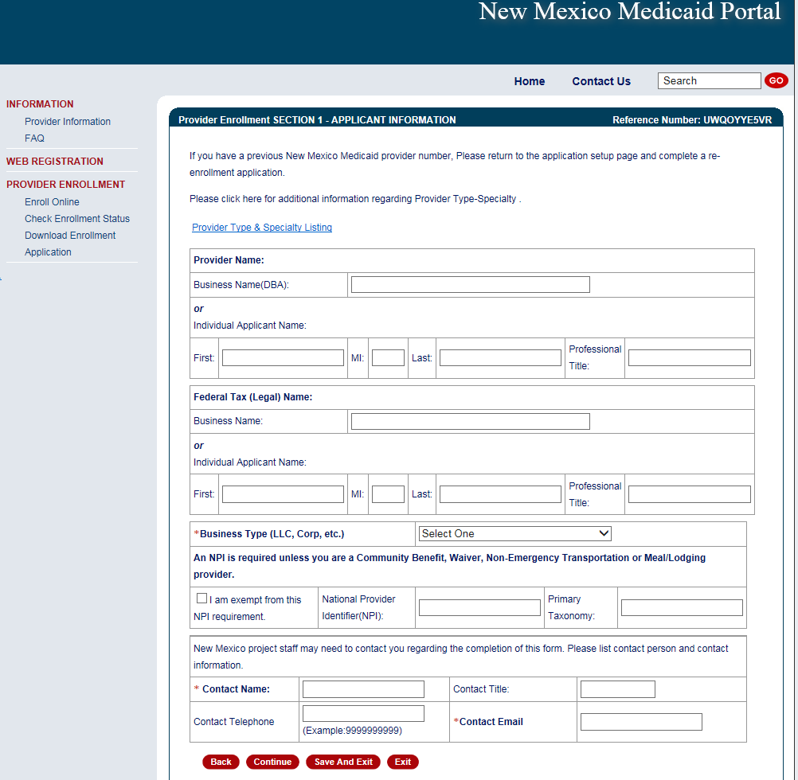
Web Portal Application Submission Process – MAD 335
Enter business name or individual name
Note: Type 1 NPIs are assigned to individual providers, and Type 2 NPIs are assigned to organizational providers
Notes:
If you are using a federal tax ID we expect a Type 2 NPI.

Slide 44
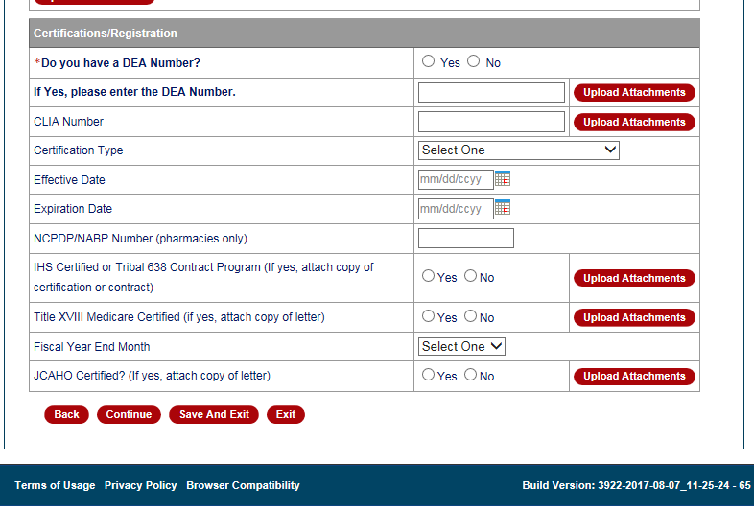
Web Portal Application Submission Process – MAD 335
Select and upload attachments that pertain to your provider type and specialty

Slide 45
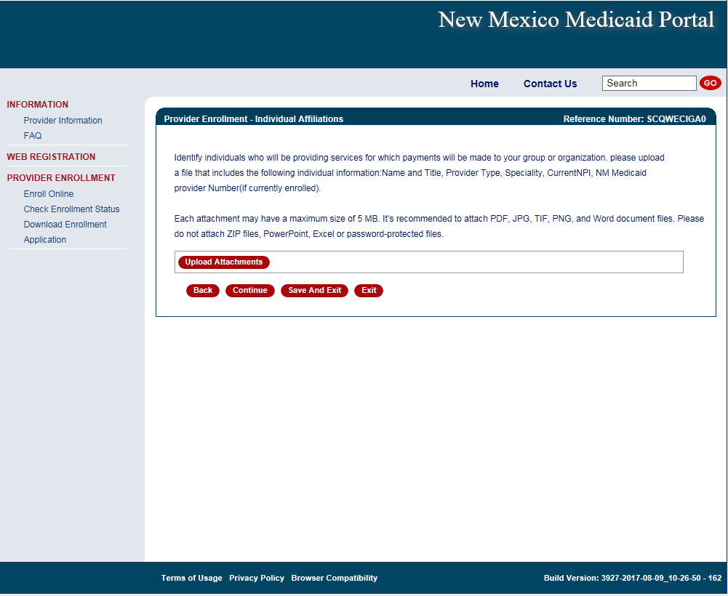
Web Portal Application Submission Process – MAD 335
Enter any/all providers that are rendering services for your group

Slide 46
Web Portal Application Submission Process – MAD 335
Select professional liability type
Notes:
If you are a midwife participating in the birthing options program be sure to also submit supplemental agreement and affidavit of insurance.

Slide 47
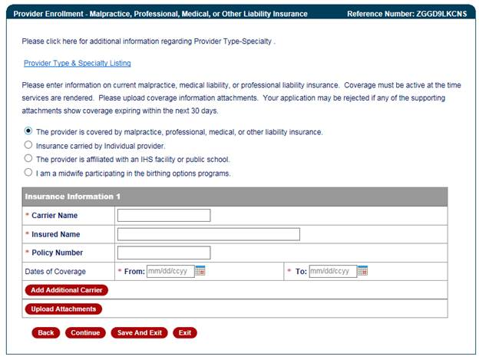
Web Portal Application Submission Process – MAD 335
Attach proof of professional liability if applicable
Attach proof of professional liability

Slide 48
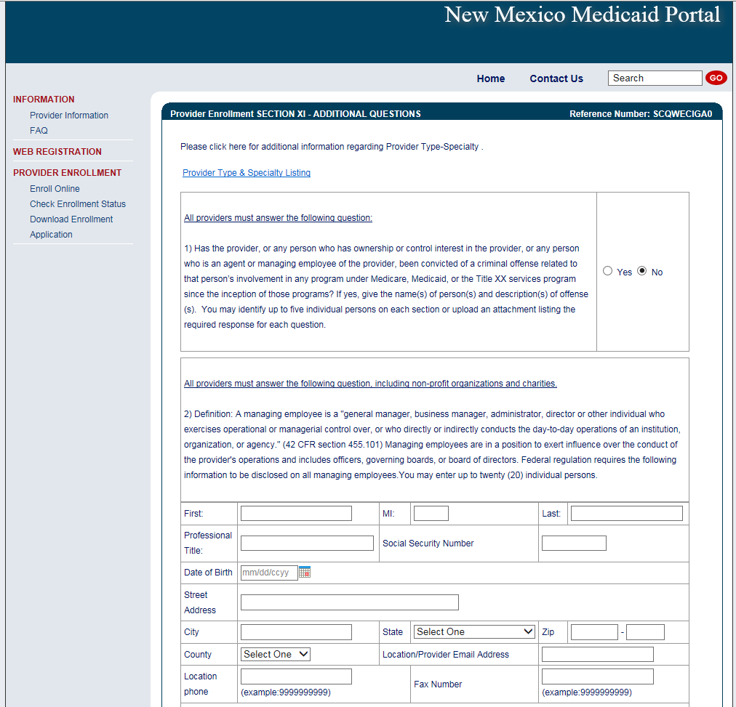
Web Portal Application Submission Process – MAD 335
All Managing Employees must be disclosed

Slide 49
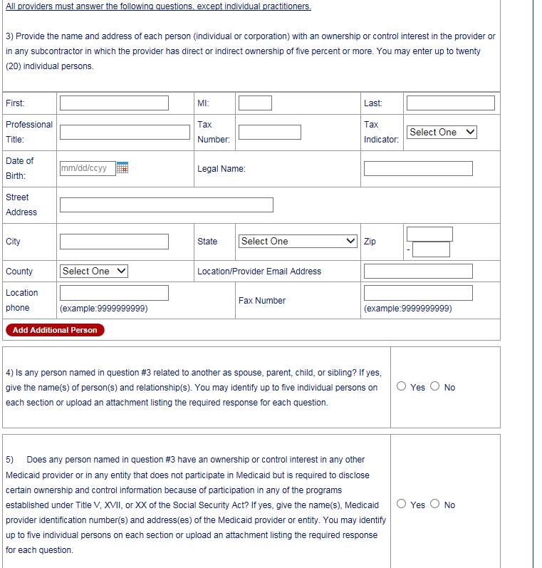
Web Portal Application Submission Process – MAD 335
Applicants must disclose any ownership of 5% or more

Slide 50
Web Portal Application Submission Process – Continued for both MAD 312 and MAD 335
Conduent
Government Healthcare Solutions

Slide 51
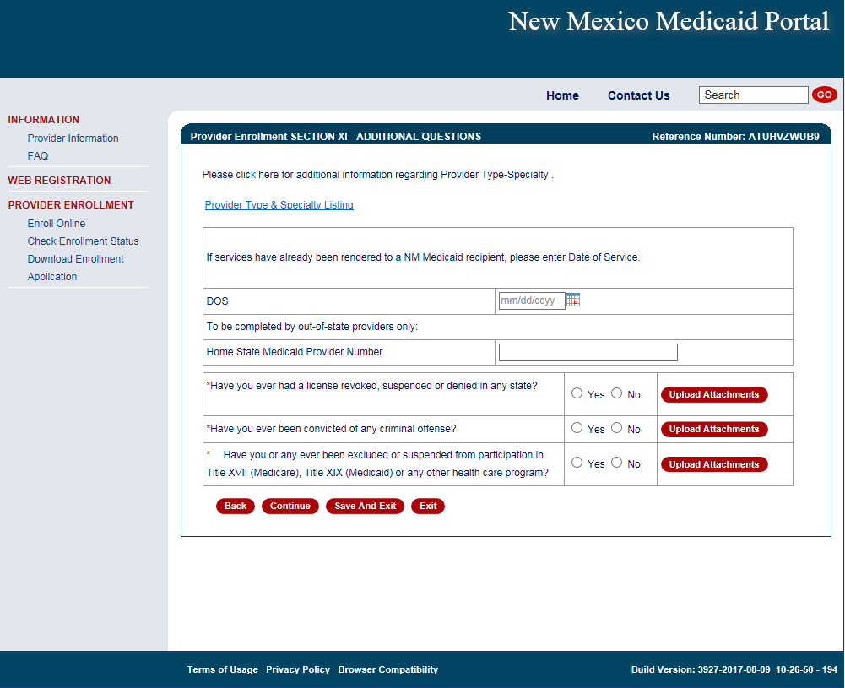
Provider Enrollment Application
Any “yes” answers to questions require supporting documentation
Note: If services were rendered to a Medicaid recipient before application approval, ensure dates on all attached documents (license, board cert, insurance) encompass all the Date(s) of Service and are valid for at least 30 days from application submission date.

Slide 52
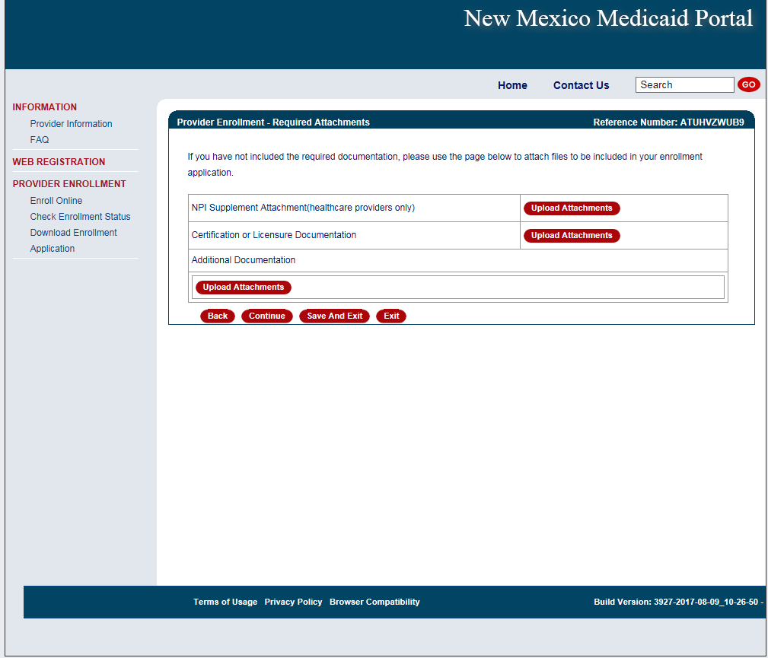
Provider Enrollment Application
Any additional documentation as required by the provider type and specialty list should be uploaded

Slide 53
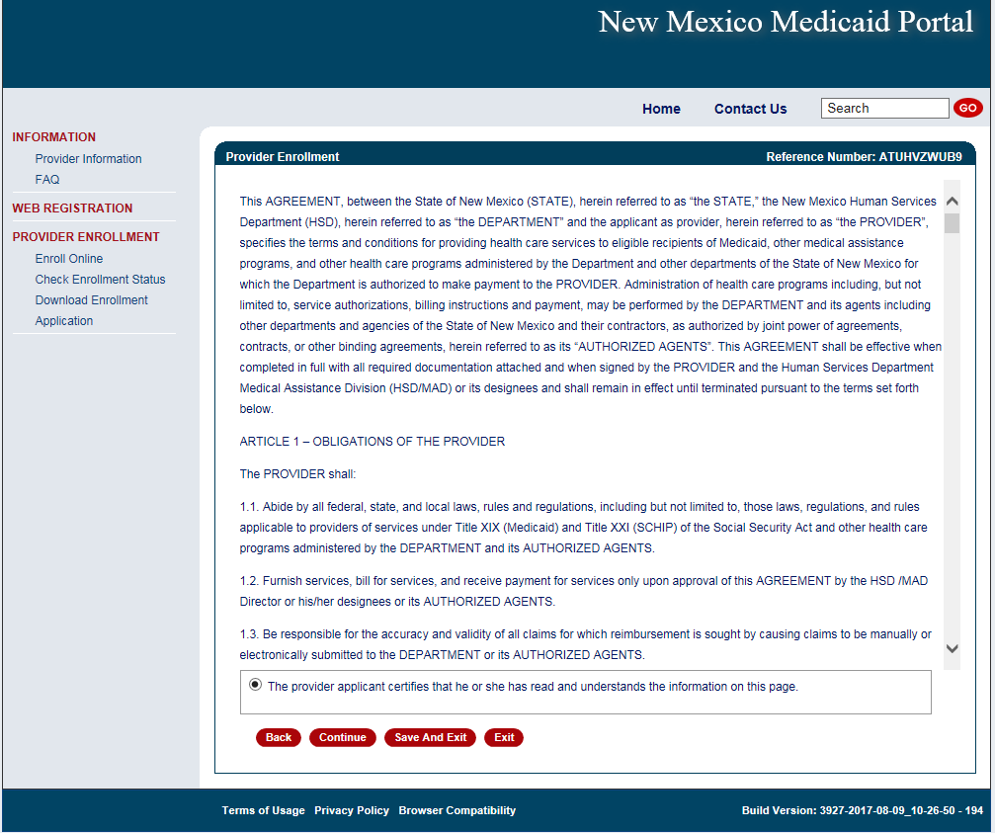
Provider Enrollment Application
Notes:
If you are filling out this application on behalf of a provider, the provider MUST read and agree to these terms.

Slide 54
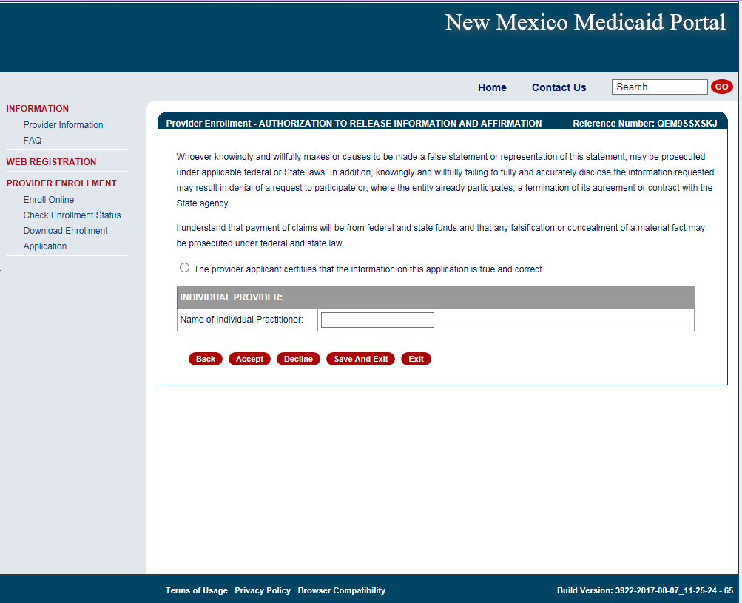
Provider Enrollment Application
Electronically sign here to acknowledge application is true and correct

Slide 55
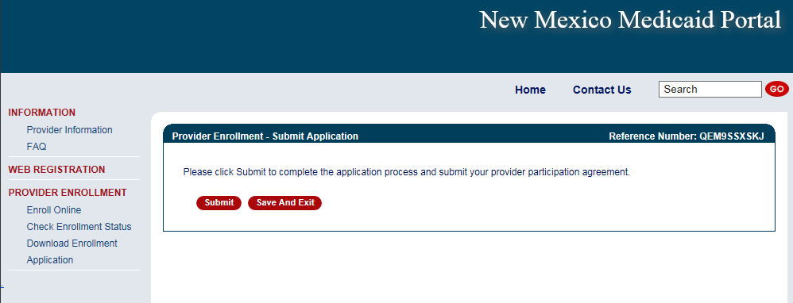
Provider Enrollment Application

Slide 56
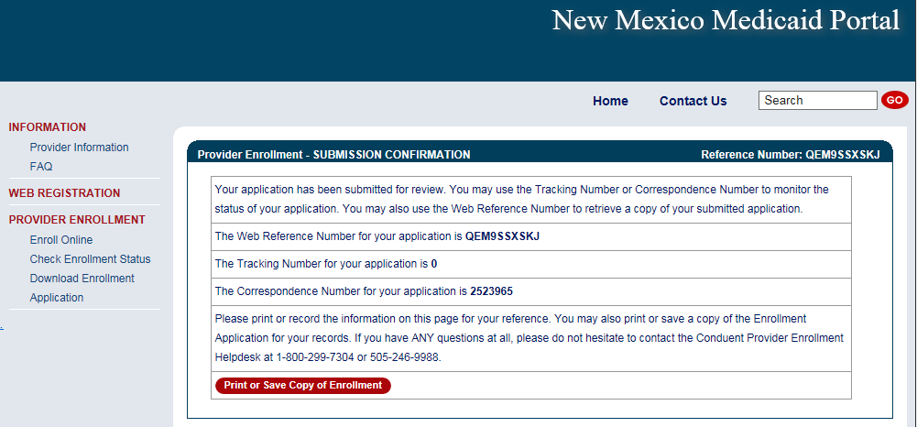
Provider Enrollment Application
Congratulations! Your application has been submitted. Be sure to keep your reference number, tracking number, and correspondence number.

Slide 57
Provider Enrollment Application Initial Screen
Recall Your Existing Application section:
If a provider left an application incomplete and did NOT submit it at all, you will have 90 days to recall the application, complete it, and submit via the portal.
If you forgot your reference number, enter your email and click submit.

Slide 58
Application Tips
Conduent
Government Healthcare Solutions

Slide 59
Provider Enrollment Applications Top Errors
Expired License or Insurance
Tip: To ensure processing is not delayed, validate that the license or Certificate of Insurance (COI) expiration dates is greater than 30 calendar days from the day Conduent receives your application.
Incorrect National Provider Identification Number (NPI)
Note: Applications using a Social Security Number (SSN) need a Type 1 NPI, and applications using a Federal Employer Identification Number (FEIN) need a Type 2 NPI.
Tip: We recommend visiting the National Plan and Provider Enumeration System (NPPES) website to ensure the correct NPI is entered on the application. The NPPES website is listed directly below:
https://npiregistry.cms.hhs.gov/
Notes:
Disclosure notice – a pending application does not guarantee activation.

Slide 60
Provider Enrollment Applications Top Errors Continued
Incomplete or Missing Information – IRS Letter/W-9 or Approval Letters
Tip: We recommend you refer to the Provider Type and Specialty List before submitting your application in order to review the required attachments for your specific provider type.

Slide 61
Return to Provider
Conduent
Government Healthcare Solutions

Slide 62
Return to Provider
If an application contains errors and/or missing/incorrect documentation, the provider will receive timely notification (via email) detailing the corrections needed before resubmitting the complete application to Conduent for review
This process is referred to as “Return to Provider” (RTP)

Slide 63
Return to Provider
Reopen and Resubmit Your Returned Application section:
Have 6 months to reopen the application, make corrections and resubmit to us via the portal

Slide 64
Return to Provider
If a provider reopens their RTP application and does not resubmit during that session, you will have 90 days to resubmit that application using the recall option.

Slide 65
Turn Around Document (TAD)
Conduent
Government Healthcare Solutions

Slide 66
Turn Around Document (TAD)
The purpose of the Turn Around Document (TAD) is to re-verify the provider information we have is current.
TADs are issued to all enrolled providers every three years.
A total of five TADs are issued (if necessary) according to the following schedule:
Two months prior to renewal date (1st & 2nd notices)
Renewal month (3rd notice)
One month after renewal date (4th notice)
Two months after renewal date (5th notice)
If the provider fails to submit a completed TAD in response to at least one of the notices, the provider record will be terminated for no re-verification.
Notes:
Please respond promptly. If at all possible, reply to the 1st or 2nd notice to allow enough time for processing the request prior to your re-verification period expiring. Consider the 3rd – 5th notices as final warnings. The processing times for TADs is 5 business days.
After termination for non-response, provider may have to submit a new application.
If you have any questions or issues please contact the Conduent Provider Relations Call Center – (800) 299 - 7304 option 6 or (505) 246 - 0710 option 6

Slide 67
Turn Around Document (TAD)
Common Mistakes:
Altering a document to match a different person/business - The TAD belongs to the person/business it is printed for and is identified by the provider number/NPI.
Using white out or line out - If a correction is required, strike a line through it and initial next to the correction.
Missing or invalid signature - Signature must be in blue ink.
Missing initials - An initial next to the three disclosure questions is required.
Faxing in a TAD - Faxes are not accepted, only hard copies with original signature will be processed.

Slide 68
Online Provider Update
Conduent
Government Healthcare Solutions

Slide 69
Advantage of Submitting Updates Online
Previously, providers were required to manually complete the MAD 304 form and submit to Conduent via US Mail, fax, or in person. This could take up to 10 business days to process.
Submitting update requests online significantly reduces the processing time; within 5 business days to process.
Using the online form will ensure that providers are using the most up-to-date version for update requests. This will reduce delays in processing of the update.

Slide 70
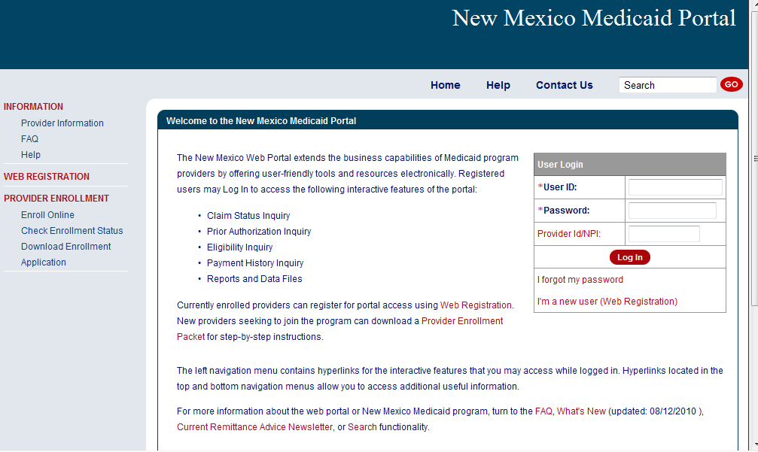
New Mexico Medicaid Web Portal Login
Log in at: https://nmmedicaid.portal.conduent.com/static/providerlogin.htm
Non Secure Features
Notes:
Speaker Notes: Secure versus Non-Secure functions

Slide 71
New Mexico Medicaid Web Portal Login
Log in at: https://nmmedicaid.portal.conduent.com/static/providerlogin.htm
Master Administrators (MA) are the only users who can initially access the Provider Update section as well as assign User Rights to others.
Secure Features requires login
If you are not the MA, you can gain access to make updates by contacting your MA and asking them to grant you the Provider Update Security Privilege.
If you need assistance logging in to the NM Web Portal, please contact the HIPAA Helpdesk at 1-800-299-7304 options 6, then 4 or by email at: HIPAA.Desk.NM@Conduent.com.
Notes:
Speaker Notes: Secure versus Non-Secure functions

Slide 72
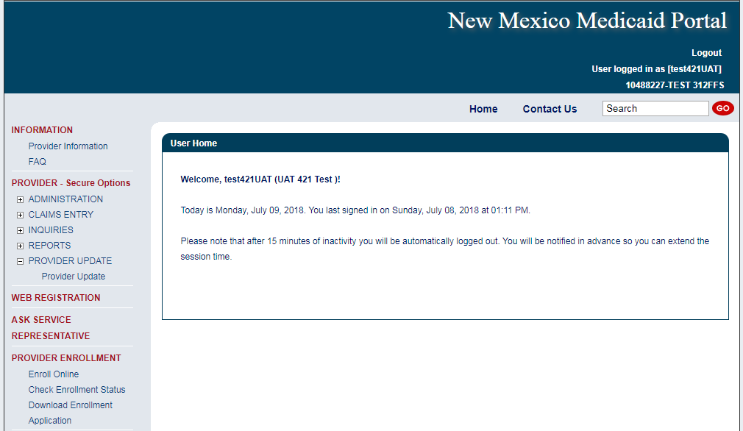
Provider Update
Web Portal Master Administrators and Users with the assigned privilege will be able to access the tool from the left navigation pane after logging in.
Notes:
Select “Provider Update.” Location: PROVIDER (Secure Options) > PROVIDER UPDATE > Provider Update

Slide 73
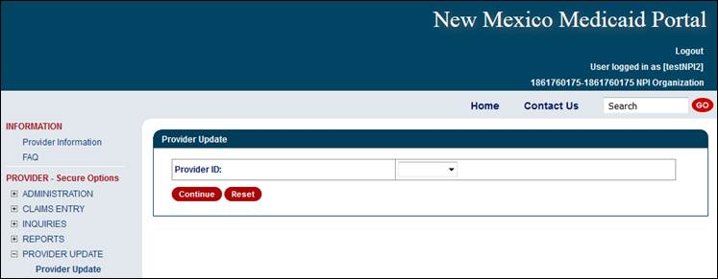
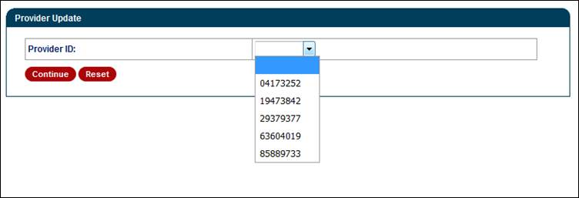
Provider Update Access Continued
Select ‘Continue’ after a provider number has been selected.
Notes:
For Group NPIs – Select the provider number (in which is to be updated) from the drop down option.
Individual NPI – After selecting “Provider Update” from the left window pane; NO option for a drop down selection. It will take you straight to the category section. Examples can be seen in the “Billing and Unrestricted Providers” and “Rendering Providers” sections of this PPT.

Slide 74
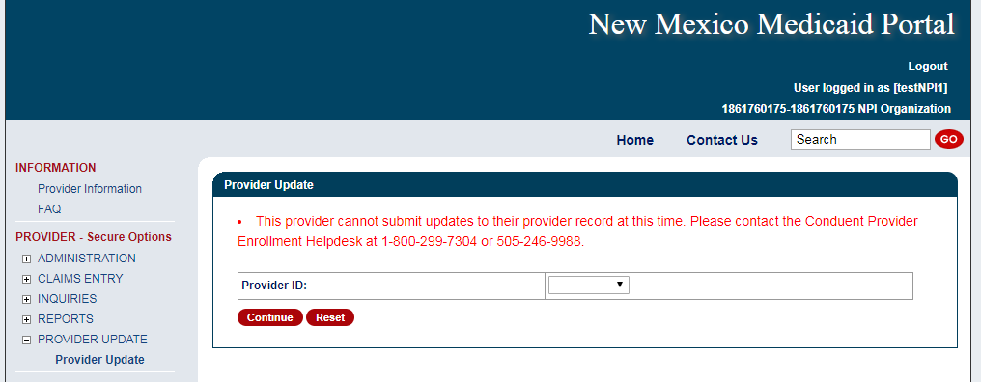
Provider Update Access
Providers may see the following error message to contact Conduent for guidance on moving forward with any provider record changes.
Notes:
The following screen will be shown after clicking the Provider Update option if the update requirements are not met. Requirement are presented on the next slide.
The Provider must be in an Active (60) or a recently Expired License (04) status. The billing code for the providers file must also be identified as either Billing, Unrestricted, Service or Crossover Only.

Slide 75
Provider Update Access Continued
Upon enrollment with NM Medicaid, providers are classified as billing providers, rendering/servicing providers, or unrestricted providers
Fee for Service billing, rendering, and unrestricted providers will have separate screens tailored to their application needs for updating purposes
Billing Provider - A provider or organization that can bill for a claim
Rendering Provider - A healthcare provider who performs the service(s). Also called 'servicing' provider
Unrestricted Provider - Providers that are billing and servicing providers
Active providers or providers with a recently expired license will be able to access the tool

Slide 76
New Mexico Medicaid Resources
New Mexico Medicaid Online
Provider Information
Provider Login Screen Notices
Provider E-News Newsletters
Medicaid Provider Relations Call Center
Provider Communication Updates
Provider Field Representative
Provider Webinars
Open Forums and Live Training Sessions
Continued on next page . . .

Slide 77
New Mexico Medicaid Resources Continued
New Mexico Medicaid Portal – https://nmmedicaid.portal.conduent.com/static/index.htm
Claim Inquiries, Eligibility Verification, Electronic Claim Submission, Provider Manuals, E-News
NM Human Services Department – http://www.hsd.state.nm.us/mad/
Supplements, Memos, Provider Billing Packets and Policy
Medical Assistance Division – PE Program Staff – HSD.PEDeterminers@state.nm.us
Assistance with PE Applications, PE Determinations, MAD 070, PE Training, PE Certification
Conduent Provider Relations Call Center – (800) 299 - 7304 option 6 or (505) 246 - 0710 option 6.
Claim Status, Eligibility, Prior Authorization, Medicaid Updates
Conduent Provider Relations Helpdesk – NMProviderSUPPORT@conduent.com
Claim research assistance and general Medicaid inquiries
Conduent HIPAA Helpdesk – HIPAA.Desk.NM@conduent.com Assistance on NM Web Portal, EDI inquiries, and Online Claim Submission with DDE (Direct Data Entry)
Conduent Provider Enrollment Helpdesk - NMProviderSUPPORT@conduent.com
Provider Enrollment Applications, Forms & Instructions
NM Medicaid Recipient Helpdesk – (888) 997 – 2583 or (505) 247 – 1042
Eligibility inquiries, Fee-for-Service Replacement Medicaid Identification Card, Enroll or change a Managed Care Organization and Eligibility application status
Medical Assistance Division, Program Rules – http://www.hsd.state.nm.us/providers/rules-nm-administrative-code-.aspx
NMAC for Programs administered by the Medical Assistance Division Yes New Mexico - https://www.yes.state.nm.us/yesnm/home/index Apply, check, update, or renew Medical Assistance (Medicaid) benefits

